Slide 1

Search Google for your name and see what information comes up
Are there any pictures of you that come up in the search results? Yes
Are there any social media accounts that come up in the search results? Yes
Search popular sites such as Facebook, LinkedIn, YouTube, etc. to see what information about you is publicly available
What personal information where you able to come up with? Contact information, Educational qualifications, Close friends' detail
Could someone find out where you live? Yes
Could someone find out where you work? Yes
Could someone find out where you go to school? Yes
What other information is available?
Marital Status - Available
Sex - Available
Age - Available
DOB - Available
Has an account associated with your email address been compromised? Yes

Slide 2
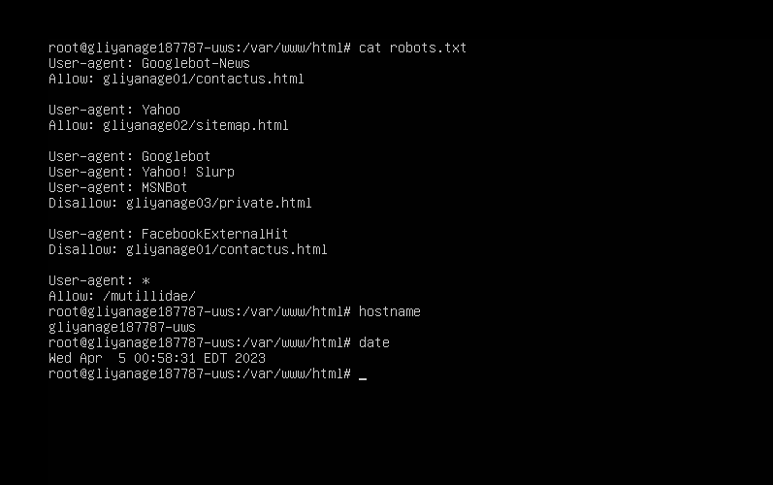

Slide 3
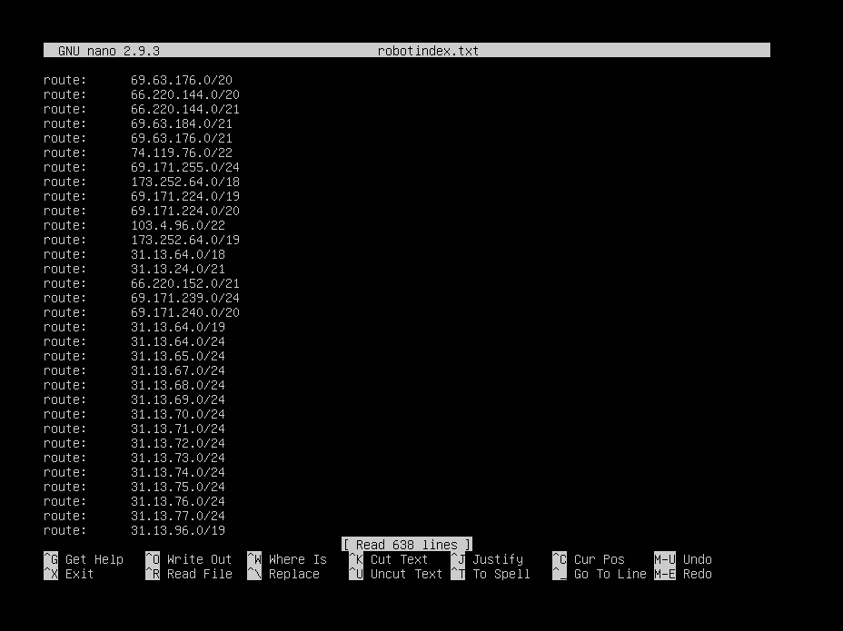

Slide 4
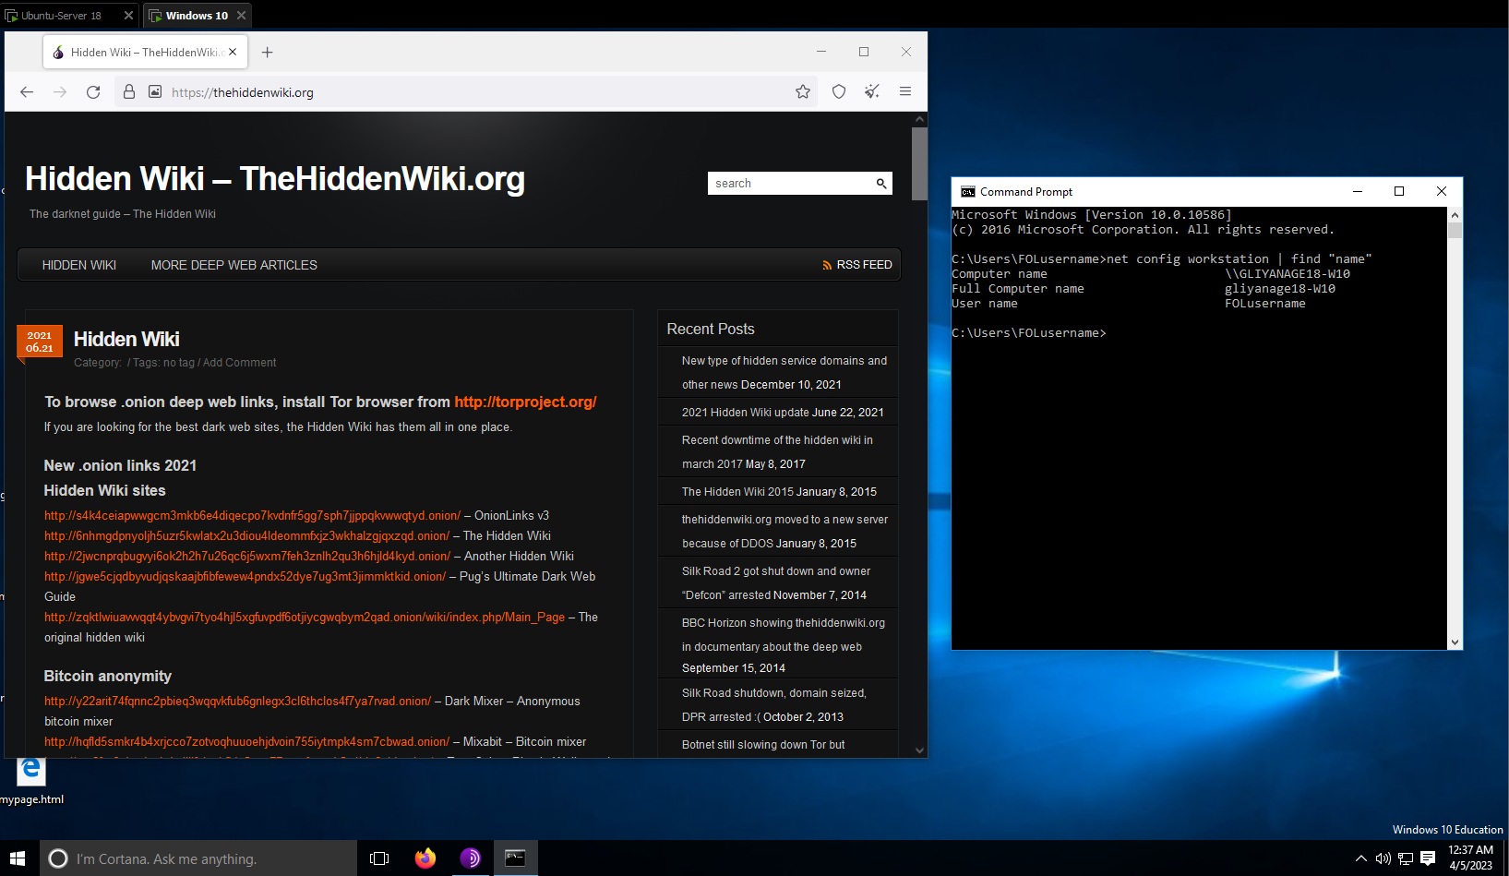

Slide 5
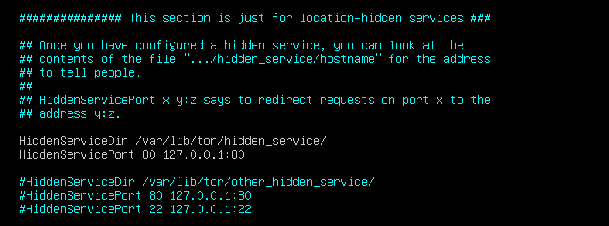
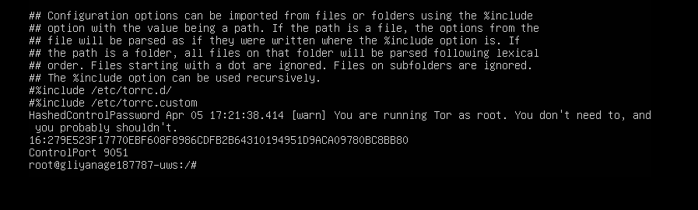
I placed HiddenServiceDir /var/lib/tor/hidden_service/http and HiddenServicePort 80 127.0.0.1:80
under the section for location-hidden services in /etc/tor/torrc.
Therefore, I captured 2 screenshots for slide 05

